Slide 1

Smart Waste management Using IOT
By
Nikita Patil (22106081)
Neha Shirsat (22106082)
Aryan Kharat (23206001)
Project Guide
Prof. Sumeet Shingi

Slide 2
Outline
Introduction
Literature Survey of the existing systems
Limitations of the existing systems
Problem statement and Objective
Proposed System
Experimental Setup
Implementation
Conclusion
References
Research Paper Publication / Patent/ Copyright status

Slide 3
INTRODUCTION
Urban waste management is a growing challenge due to increasing population and waste generation.
Traditional waste collection methods are inefficient and often lead to overflowing bins.
IoT technology enables real-time monitoring and smarter waste management solutions.
The project aims to automate and optimize waste collection using sensors and cloud connectivity.
Data-driven approaches can improve resource allocation and reduce operational costs.

Slide 4
OBJECTIVES
To design and implement a smart IoT-based waste management system that monitors garbage bins in real time using sensors.
To integrate real-time sensor data (e.g., fill level, flame detection) with a central web application for continuous monitoring.
To provide secure user authentication and role-based access control for Municipal authorities, Drivers, and Citizens.
To deploy the system using Vercel CI/CD pipeline for automated updates and real-time accessibility.

Slide 5
LITERATURE SURVEY OF THE EXISTING SYSTEM
SR.no | Paper Title | Authors | Review
1. | Smart Waste Bin with Real-Time Monitoring System ( | Norfadzlia MohdYuso, Mohd Faizal Zulkifli, Nor Yusma Amira Mohd Yusof, Azziana Afififie Azman4 | Presents a low-cost smart bin using Arduino, Ultrasonic Sensor, PIR, ESP8266, and GSM. Provides web & SMS alerts. Serves as a base prototype but depends on Wi-Fi and lacks long-term power efficiency analysis.
2. | IoT Based Waste Management for Smart City (2016) | Parkash Tambare, Prabu Venkatachalam | Demonstrates RF-based waste monitoring with 8051 MCU, IR sensors, RF modules, and Intel Galileo. Provides a transmitter–receiver design but lacks real-time cloud integration and scalability

Slide 6
3. | An IoT-based Bin Level Monitoring System for Solid Waste Management (2020) | Jino Ramson, jackuline Moni, Vishnu Suresh, Theodoros anagnostopoulos | Uses Ultrasonic Sensor, ATSAMW25 (Wi-Fi), MQTT, and solar harvesting. Achieves long battery life (434 days) and wide range (119m). Well validated, but no lid automation or gas detection.
4. | IoT-Enabled Solid Waste Management in Smart Cities (2021) | S.Vishnu, R.Jino Ramson, Samson Senith , Theodoros Anagnostopoulos, Adnan M. Abu-Mahfouz,Xiaozhe Fan, S. Srinivasan, A.Alfred Kirubaraj | Proposes hybrid LoRaWAN + Wi-Fi network with ultrasonic sensors and GPS. Tested on 16 bins. Scalable for smart cities, but battery life (~70 days) is shorter compared to solar solutions.
5. | IoT-Enabled Real-Time Monitoring of Urban Garbage Levels Using ToF Sensing Technology (2025) | Luis Miguel Pires, Joao Figueiredo, Ricardo martins, Jose martins | Introduces ToF sensor (VL53L8CX) with ESP32-S3, Cloud API, and 3D visualization. Improves fill-level accuracy and visualization. Focuses on data quality, less on network scalability.

Slide 7
LIMITATIONS OF EXISTING SYSTEMS
Manual collection schedules do not adapt to actual bin fill levels, causing inefficiency.
Overflowing bins and missed pickups are common due to lack of real-time data.
No integration of hazardous gas detection or predictive analytics in most current systems.
High operational costs due to unnecessary collection trips.
Limited transparency and feedback for municipal authorities and citizens.

Slide 8
PROBLEM STATEMENT
Fixed waste collection schedules cause bins to overflow or be emptied unnecessarily.
No real-time monitoring leads to delayed response to hazardous or unsanitary conditions.
Manual tracking is inefficient and prone to errors.
Inefficient route planning increases operational costs and environmental impact.
Lack of actionable data prevents authorities from optimizing waste management resources.

Slide 9
SUSTAINABILITY DEVELOPMENT GOAL ALIGNMENT
SDG 3 Good Health and Well-being: Ensure healthy lives and promote well-being for all ages.
SDG 9 Industry, Innovation and Infrastructure: Build resilient infrastructure, promote sustainable innovation industrialization, and innovation.
SDG 11 Sustainable Cities and Communities: Make cities and human settlements inclusive, safe, resilient, and sustainable.
SDG 16 Peace, Justice and Strong Institutions: Promote peaceful and inclusive societies with justice for all.
SDG 17 Partnerships for the Goals: Strengthen the means of implementation and revitalize the global partnership for sustainable development.

Slide 10
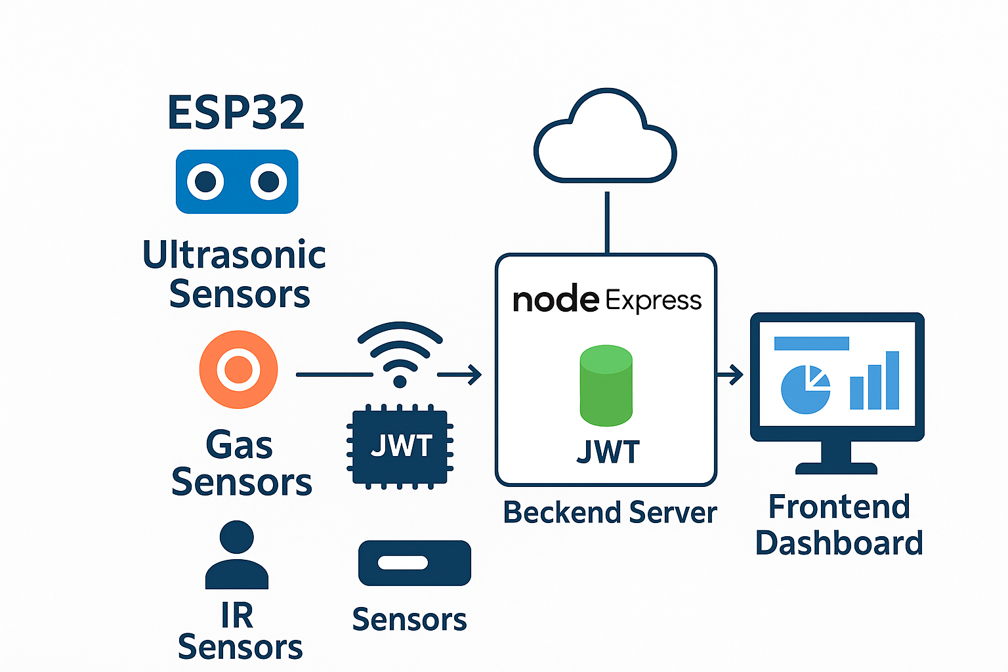
SYSTEM DESIGN

Slide 11
TECHNOLOGY/TOOLS
ESP32 with Ultrasonic, IR, and Gas Sensors for real-time bin monitoring and wireless data transfer.
Node.js + Express backend with MongoDB for storing sensor and user data securely.
RESTful APIs connect hardware, backend, and frontend with JWT authentication and CORS security.
Frontend Dashboard (HTML, CSS, JS) provides live bin status, alerts, and user access.Deployed on Vercel with GitHub Actions, using environment variables and error handling for reliability.

Slide 12
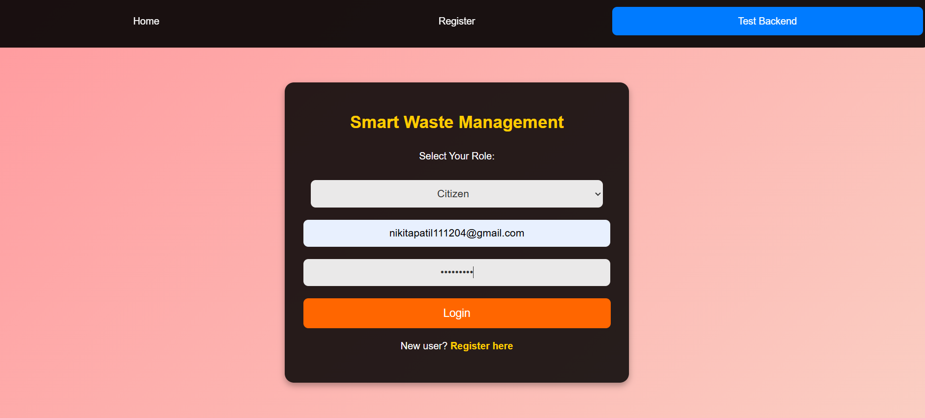
IMPLEMENTATION

Slide 13
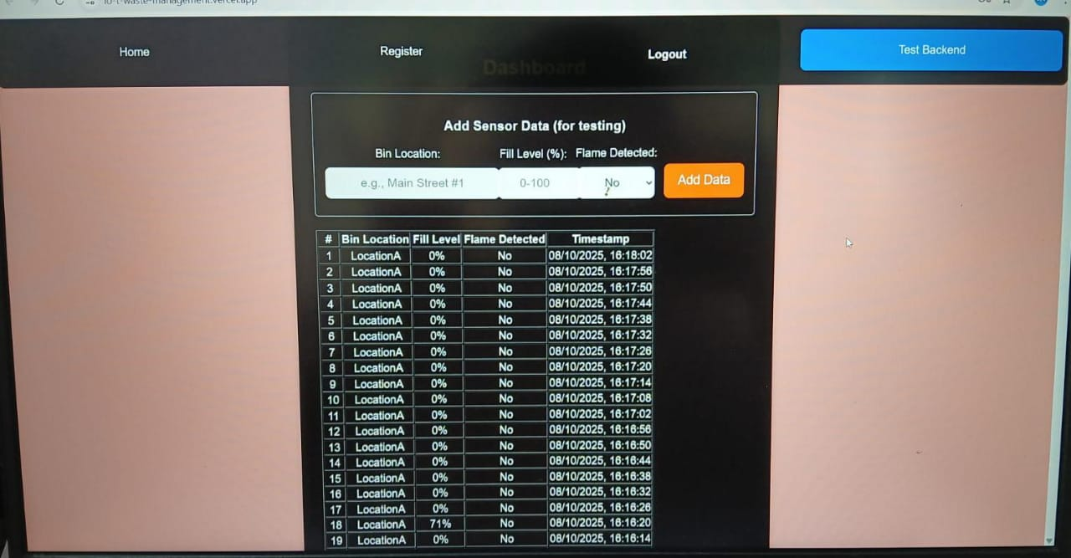
IMPLEMENTATION

Slide 14
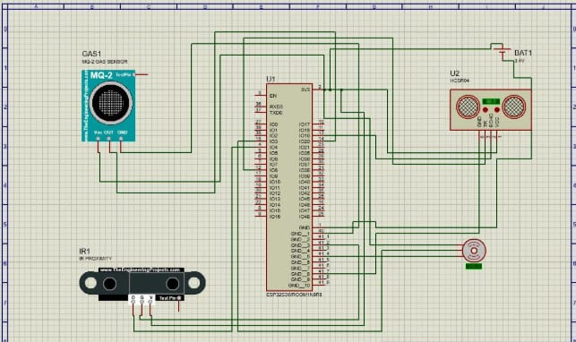

Slide 15
CONCLUSION
The IoT-Based Smart Waste Management System efficiently monitors waste levels using ESP32 and sensors, sending real-time data to a secure Node.js backend with MongoDB. A web dashboard displays live status and alerts, enabling timely waste collection. The system reduces manual effort, ensures cleaner surroundings, and supports smart city sustainability.

Slide 16
REFERENCES
http://www.sciencepubco.com/index.php/IJET/article/view/20026
https://www.researchgate.net/publication/323280336_IoT_Based_Waste_Management_for_Smart_City
https://doi.org/10.1007/s10163-020-01137-9
https://doi.org/10.3390/smartcities4030053
https://doi.org/10.3390/s25072152

Slide 17
THANK YOU...!!

